Slide 1
Problem Statement
Current Applications are residing on Legacy iSeries box. SEU is still used as source editor. Plan is to apply DevOps to all the existing Applications using ARCAD Software without modernizing those application.

Slide 2
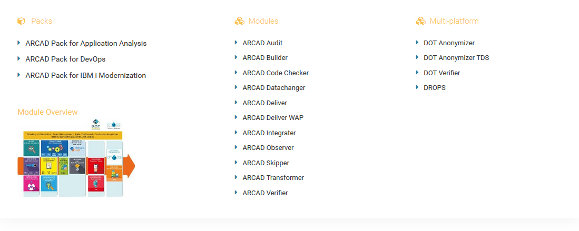
ARCAD Products

Slide 3
Queries
What is pre-requisite for adopting ARCAD pack for DevOps for Legacy iSeries Application?

